Slide 1
History, Development, and Realities of Pancasila During The Old Order (1945-1965)
George Owen Lie
Robby 2301931043
Matthew Setiawan 2301891033
Mika Mahaputra 2301923962
Gadtardi Wongkaren 2301929480

Slide 2
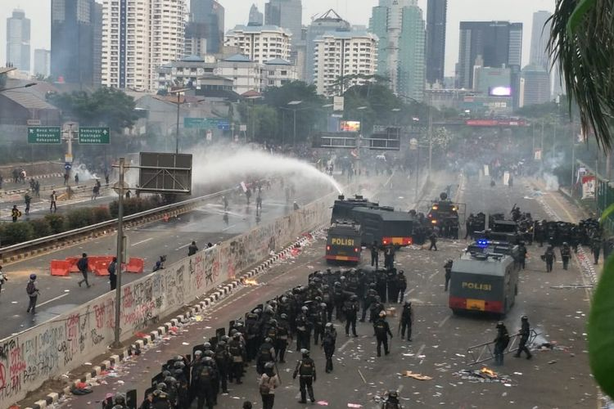
Quo Vadis Indonesia?......

Slide 3

What will we discuss?
Some background of Pancasila formulation
Historical changes to Pancasila text
Challenges to Pancasila implementation
Realities of Pancasila implementation in the discussed era

Slide 4
Sub-Division of Era
1945-1950: Pre-Independence, Independence Struggles
1950-1959: Era of multiple Parliaments
1959-1960: ‘Guided Democracy’ Era

Slide 5
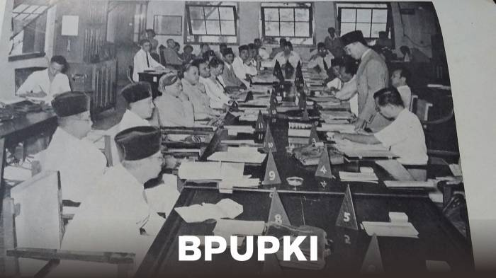
Sub-Era 1: 1945-1950 Independence and Early Struggles

Slide 6
Sub Period 1 1945-1950 Historical Background:
Imminent Defeat of Japan in WW2
‘Rushed’ need to prepare for Indonesian Independence
Indonesian Independence itself
Dutch attempts to take back Indonesia in Agresi Militer Belanda 1&2
Rebellions by multiple political factions (e.g. PKI Madiun 1948 incident)

Slide 7
Challenges to Pancasila during 1945-1950
Japan was using Indonesian Independence for its own agendas
Debate on what constituted the Indonesian ‘Identity’
Debate on the shape of Indonesian Government and Nation
Conflict between multiple ideologies and identities on what Indonesia should be like/based on
Haste to establish Indonesian legal/political foundations

Slide 8
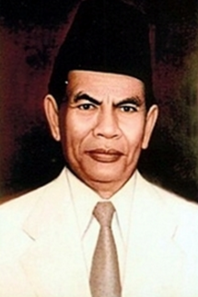
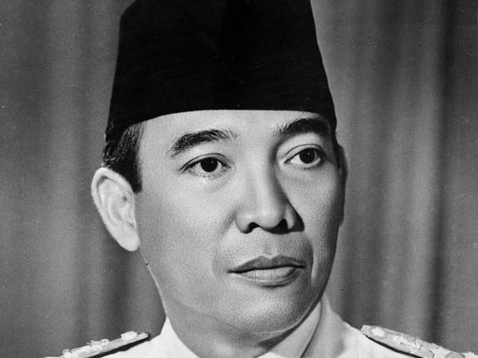
Key figures during formulation of Pancasila:
Ir. Soekarno: The first president of Indonesia,
Mohammad Yamin: important politician and linguistics expert who helped on crafting the Pancasila Text

Slide 9
Key Organizations
BPUPKI: Committee for the investigation of the preparation of Indonesian Independence (29th April 1945)
PPKI: Committee for the preparation of Indonesian Independence (7th August 1945)

Slide 10
Soekarno’s prototype
Rumusan Pancasila
Internasionalisme(peri-kemanusiaan)
Mufakat(demokrasi)
Kesejahteraan sosial
Ketuhanan yang berkebudayaan
Rumusan Trisila
Sosio-nasionalisme
Sosio-demokratis
ke-Tuhanan
Rumusan Ekasila
Gotong-Royong

Slide 11
Dr. Soepomo’s Prototype
Persatuan
Kekeluargaan
Keseimbangan lahir dan batin
Musyawarah
Keadilan rakyat

Slide 12
Mohammad Yamin’s Prototype
Peri Kebangsaan
Peri Kemanusiaan
Peri ke-Tuhanan
Peri Kerakyatan
Kesejahteraan Rakyat

Slide 13
Jakarta Charter (22 June 1945)
1. Ketuhanan dengan kewajiban menjalankan syariat Islam bagi pemeluk-pemeluknya
2. Menurut dasar kemanusiaan yang adil dan beradab
3.Persatuan Indonesia
4.Dan kerakyatan yang dipimpin oleh hikmat kebijaksanaan dalam permusyawaratan perwakilan
5. Serta dengan mewujudkan keadilan sosial bagi seluruh rakyat Indonesia

Slide 14
But What Happened?
On the evening of 17 August, A.A.Maramis and other prominent politicians from eastern Indonesia and non-muslim majority areas declared their discomfort towards the then version of Pancasila

Slide 15
18 August Ratified Version for UUD 1945
ke-Tuhanan Yang Maha Esa,
Kemanusiaan yang adil dan beradab,
Persatuan Indonesia
Dan kerakyatan yang dipimpin oleh hikmat kebijaksanaan dalam permusyawaratan perwakilan
Serta dengan mewujudkan suatu keadilan sosial bagi seluruh rakyat Indonesia.

Slide 16
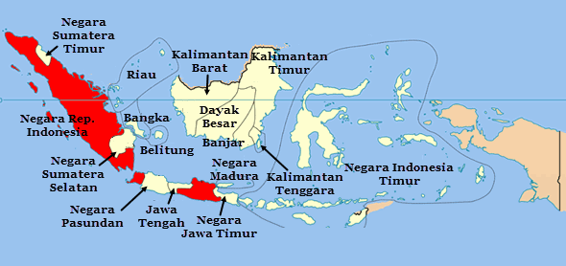
United States of Indonesia (RIS)(1949-1950)
Due to mounting military pressure from the Netherlands, the Indonesian crisis government at Jogjakarta was forced to accept the formation of a federal state called the Republik Indonesia Serikat which was in fact a ploy by the Dutch to set up a puppet state

Slide 17
RIS version:
ke-Tuhanan Yang Maha Esa,
perikemanusiaan,
kebangsaan,
kerakyatan
dan keadilan sosial

Slide 18
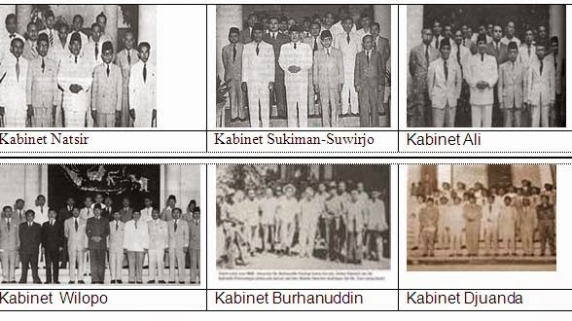
Sub-Era 2:1950-1959 Parliamentary Era

Slide 19
Sub-Era 2:1950-1959
Collapse of RIS as a result of the collapse of Dutch efforts to reconquer Indonesia due to U.S. Marshall Plan pressure
Renewed efforts to better define the legal/political foundation of Indonesia
Everything developed during 1945-1950 was seen as ‘temporary’ because of the hasty conditions

Slide 20
The UUD Sementara (Temporary Constitution) version 1950-1959
ke-Tuhanan Yang Maha Esa,
perikemanusiaan,
kebangsaan,
kerakyatan
dan keadilan sosial

Slide 21
What happened in 1950-1959
Parliamentary Indonesia with Prime Minister as head of government, President as head of state
In a period of 9 years, Indonesia had a total of 8 governments!
Increased external pressure from the Cold War
Rebellions backed by the CIA in Sumatra and East Indonesia
Increased socio-economic chaos

Slide 22

Sub Era 3: 1959-1965: ‘Guided Democracy’

Slide 23
Sub Era 3: 1959-1965: ‘Guided Democracy’
Presidential Decree of 5 July 1959
Soekarno strikes back, impatient with progress and performance of the government
Declares a revert to the UUD 1945 including the Pancasila of that version
Soekarno assumes direct control as both head of state and head of government

Slide 24
What happened in 1959-1960?
Arguably, Soekarno was becoming less stable as a person and focused on developing a cult of personality
Increased pressure from both Capitalist and Communist axis
‘Lighthouse Diplomacy’: Soekarno paid for ‘great national projects’ by printing money
Indonesians became very, very poor
Ultimately, Soekarno failed to balance between East and West

Slide 25
Reality of Pancasila in 1945-1950
Too much war made it hard to implement Pancasila
‘Hasty’ nature of deliberations made people still unsure of the real foundations of the nation
Conflicting ideologies

Slide 26
Reality of Pancasila in 1950-1959:
Still unsure of the true Pancasila
With the parliamentary system, Indonesia became very democratic very quickly, perhaps too fast?
People still suffered very greatly

Slide 27
Reality of Pancasila 1959-1965
Very very difficult conditions for ordinary Indonesians
The people’s condition was sidelined in the face of the ‘World Theatre’

Slide 28
Conclusion of 1945-1965 Era
As a great tool for the foundation of the nation, Pancasila was not fully realized of its power and not used to great effect in order to steer the nation to a good condition
Like a ‘anak baru gede’ the newly created modern nation of Indonesia was still suffering to find its identity in the world
The conditions faced by the people were very far from the ideals enshrined in Pancasila

Slide 29
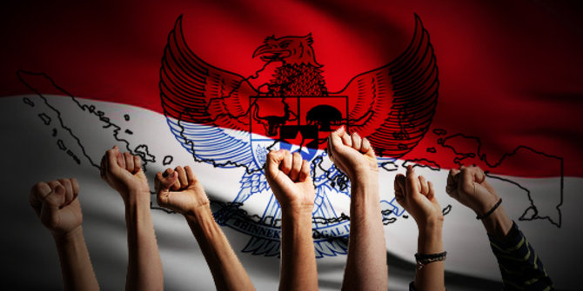
Hiduplah Pancasila!!
Thanks for your Attention!!

Slide 30
sources
https://tirto.id/sejarah-hari-lahir-pancasila-peran-bpupki-dan-ppki-cpMp
http://sosiologis.com/sejarah-pancasila

